Slide 1

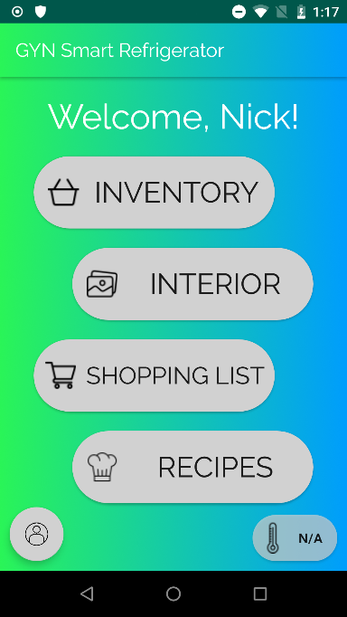


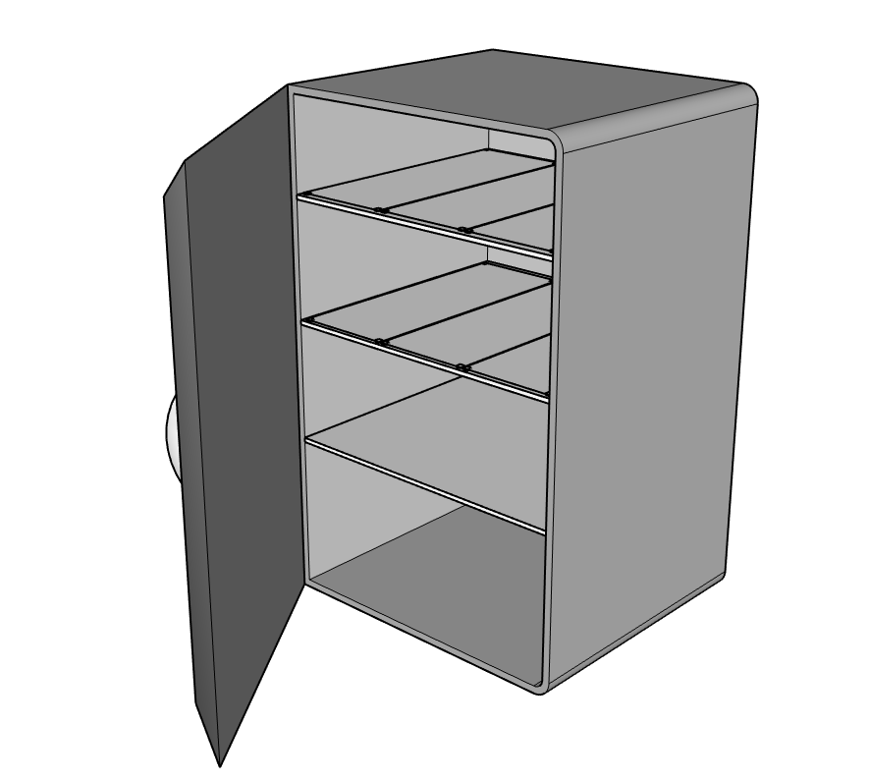
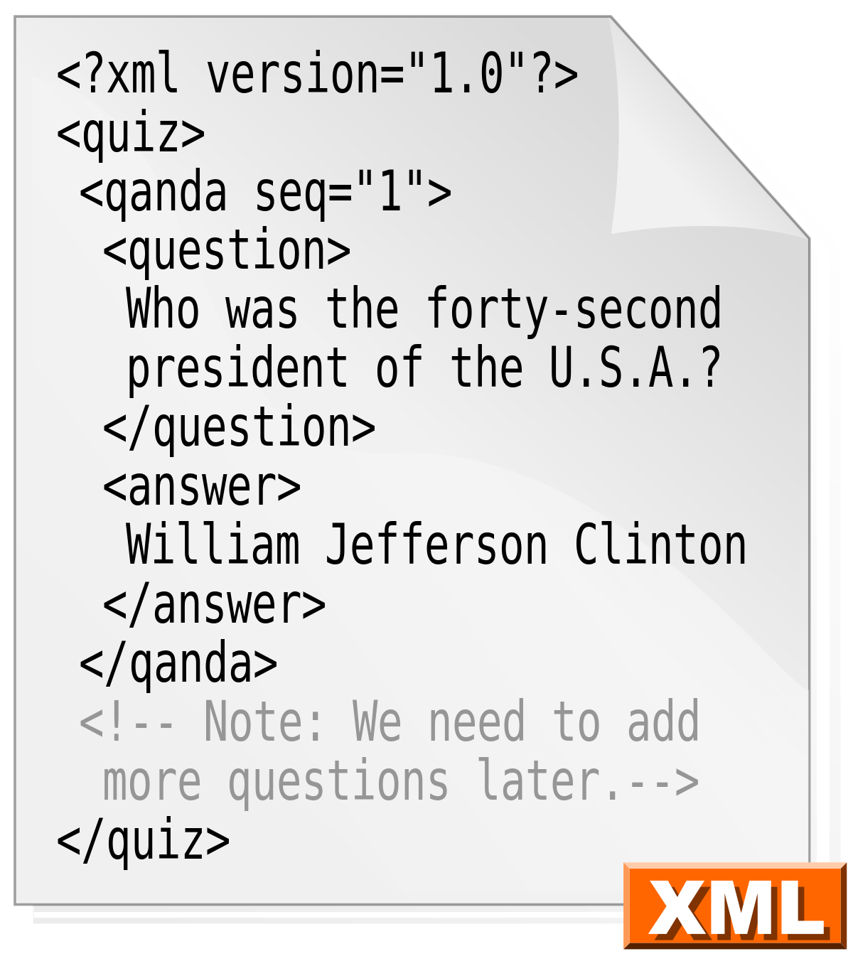


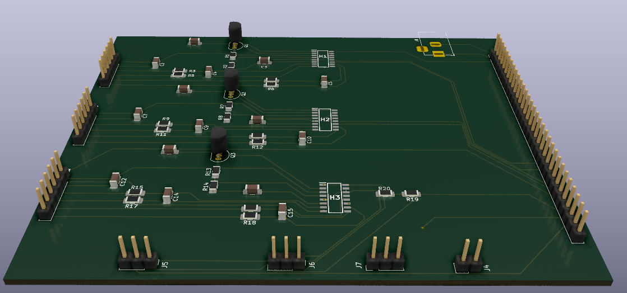
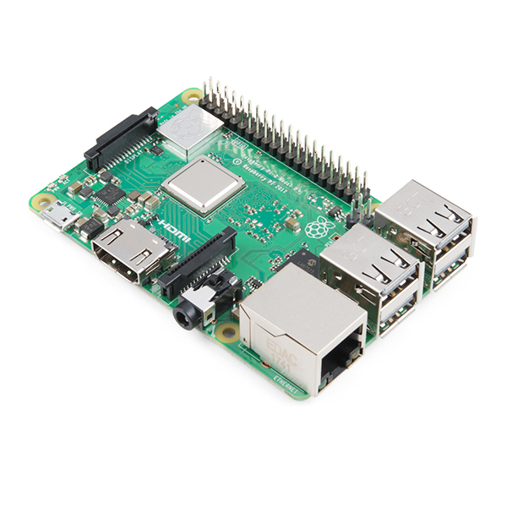
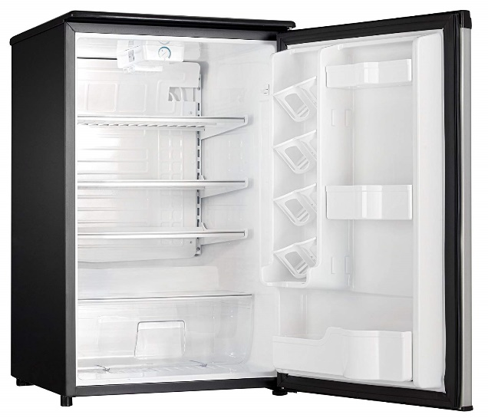
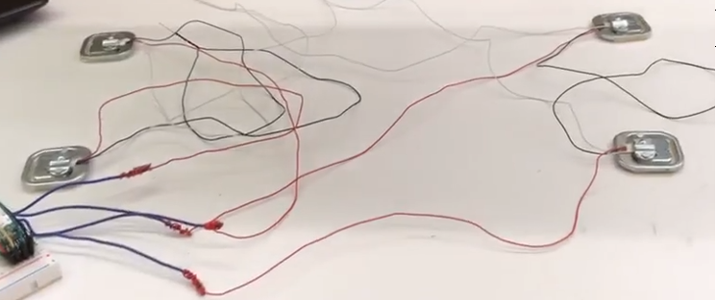
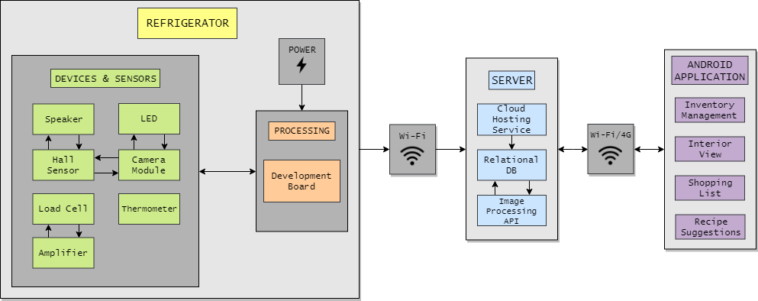
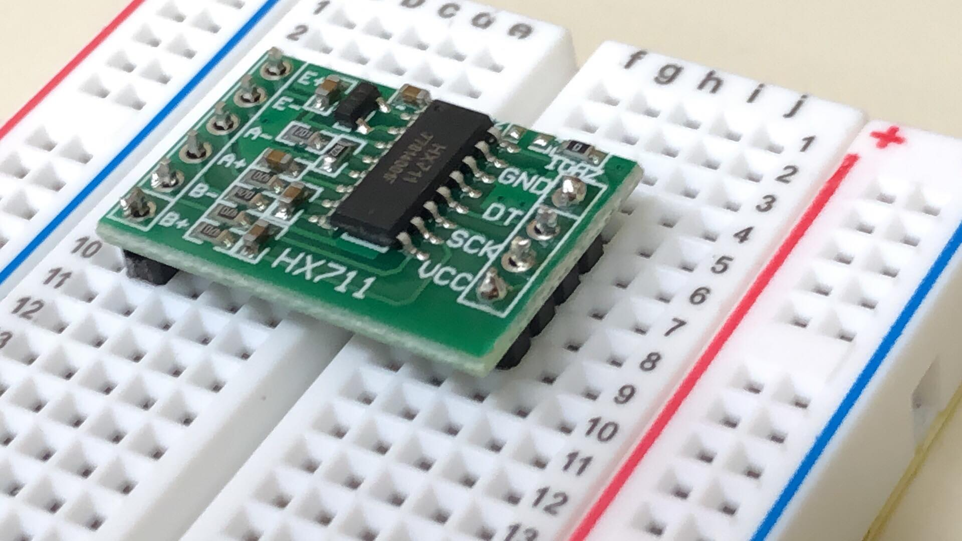

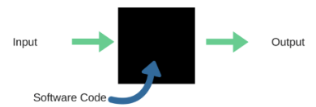

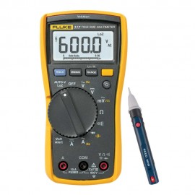



Department of Electrical Engineering & Computer Science
TEAM 25
Nicholas Pollender, Georgiy Araslanov, Gneykou Kengne Yvann Monny
Supervised by: Dr. Le Beux
The Ultra Smart Refrigerator
Objective
Software Development
Expand on existing smart refrigerator technology.
Introduce new features to smart refrigerator technology.
Visually inform users about food types and quantities.
Increase quality of life with live feed of interior and ability to create shopping lists.
Promote organization.
Promote a healthy lifestyle.
Application developed with Android Studio
SQLite databases store data locally.
XML stylesheets define the appearance of the application.
Python script automatically run on refrigerator hardware.
AWS Amazon cloud hosting service stores data with RDS for PostgreSQL and S3 bucket.
Google Cloud Vision API processes images and identifies foods.
Android Studio
Python
User Interface Design
Initial Refrigerator Design
Google Cloud Vision
Amazon AWS
XML
Features
Hardware Development
Set of scales that monitor the weight of food products.
Interior camera that monitors a shelf and identifies food items through an image processing service.
Smart shopping list that makes suggestions based of the refrigerator inventory.
Search engine for a large database of healthy recipes that can also provide results based on refrigerator inventory.
User friendly Android application with big buttons, easy to read text, and simply navigation.
Data stored in secure AWS cloud hosting service.
PCB Design – 3D Model
Raspberry Pi 3 B+
Danby Mini Refrigerator
Raspberry Pi is the main component of the operation.
PCB provides an overall interconnection between every device and sensor installed in the refrigerator.
All components added to an existing (non-smart) mini refrigerator.
4 Load Cell Configuration
System Block Diagram
HX711 Load Cell Amplifier
Problems Encountered & Solutions
Results & Conclusion
COVID-19 outbreak halted project progress, resulting in only partial completion.
A functioning prototype was procured.
Load cells require a reference unit to be calculated and set within the code to function properly.
Problem: Incorrect weights still being recorded.
Solution: Use default reference unit, and tare upon starting the program.
Black Box Testing
Various testing and validation techniques performed.
Black box testing to confirm outputs for certain inputs.
Efficiency tests.
Percent error in readings.
Validation with multimeters.
Example of BB Test
How to distinguish food items properly?
Problem: Items identifying by the image processing service may not accurately represent the actual items in the refrigerator (identifying a group of fruit as just ‘Fruit’), or identify non-food items.
Solution: Apply a manual filter to remove any non-food items found, not the most efficient but it works in the short term.
Multimeter
VS
Partial completion was achieved, the system as it stands is a functioning prototype, with just some missing hardware.
Data can be obtained from the scales, sent to the server, and received on the smart phone application.

